Slide 1
Access to Vehicle CAN Bus
Kyle Booker & Braeden Burrows

Slide 2
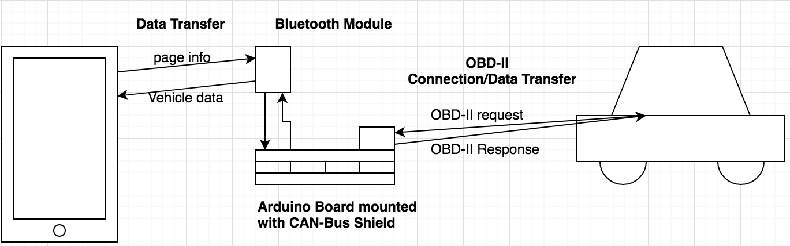
System Architecture

Slide 3
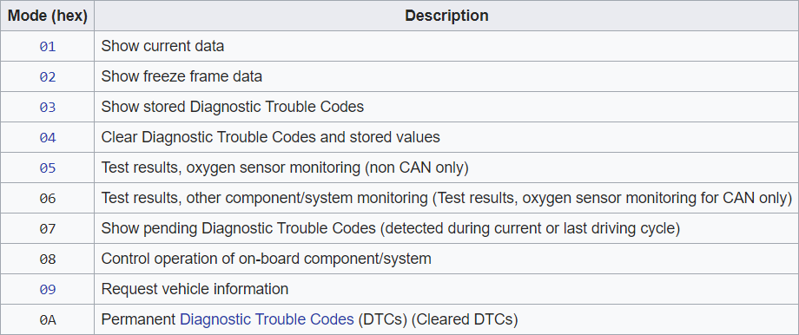
OBD-II Modes

Slide 4
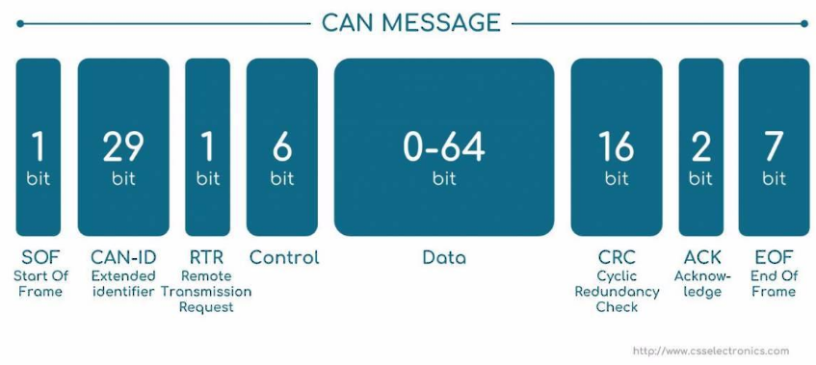
CAN Bus
CAN is a serial bus protocol that allows microcontrollers to communicate with each other without complex and dedicated wiring.
The data portion of the CAN message is made up of the message length, the OBD-II mode, the process ID and the data.

Slide 5
Arduino Program
The arduino program is divided into two major sections.
The setup function.
Initializes all variables and serial communication for both the CAN bus and bluetooth.
The main loop.
Uses information sent using bluetooth from the android device to request data from the vehicle.
Send this data to the android device via bluetooth.

Slide 6

Android Application

Slide 7
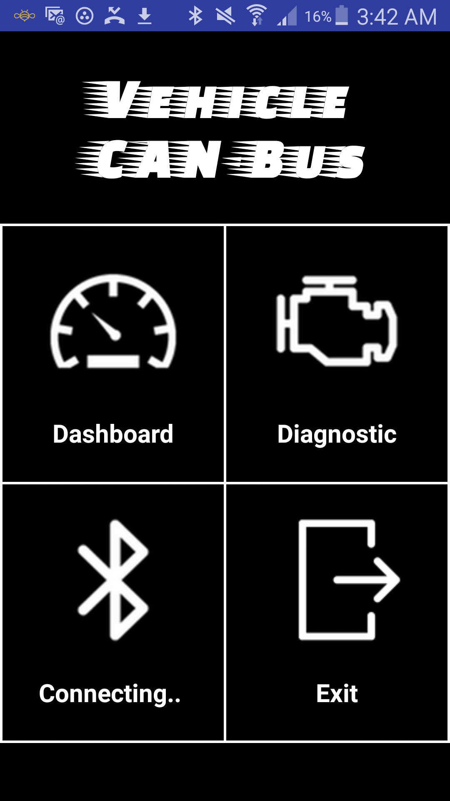
Home Page

Slide 8
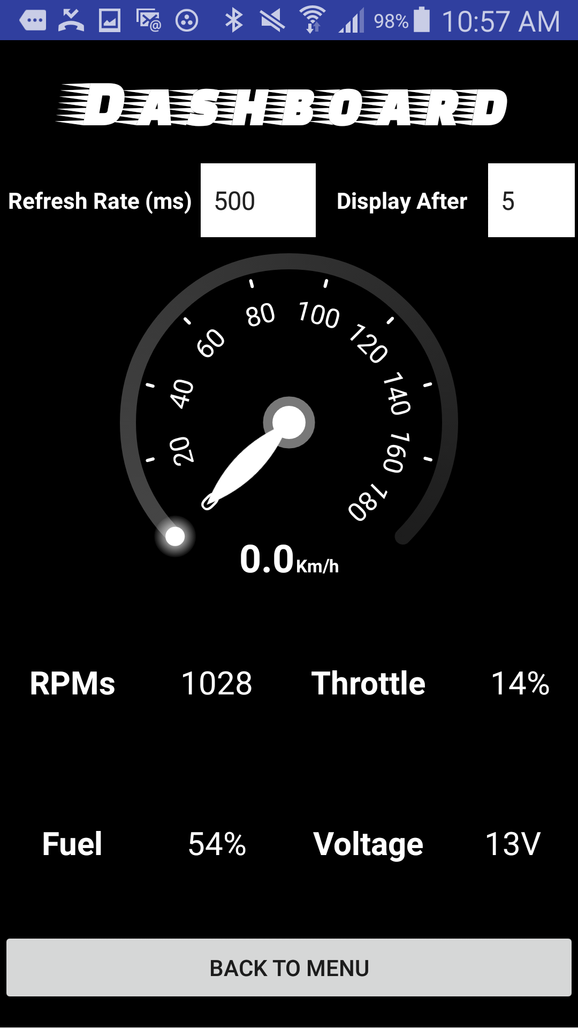
Dashboard Page

Slide 9
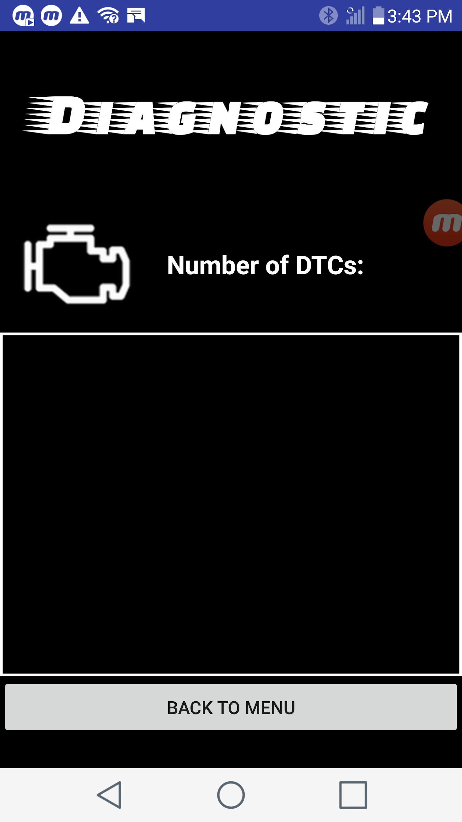
Diagnostic Page

Slide 10
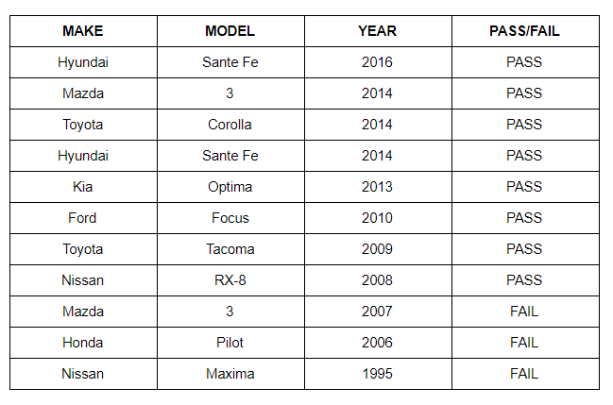
Vehicle Testing

Slide 11
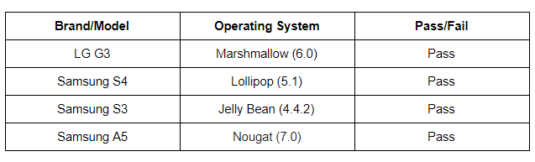
OS/Phone Brand Testing

Slide 12
